Slide 1

Detecting higher order interactions in mechanistic resource competition models
Andy Kleinhesselink¹
Jonathan M. Levine²
Nathan J.B. Kraft¹
¹Department of Ecology and Evolutionary Biology
UCLA
²Institute of Integrative Biology, ETH Zurich
Notes:
Thank you it’s great to be part of this session. And I’m glad so many of you stuck around this afternoon.

Slide 2
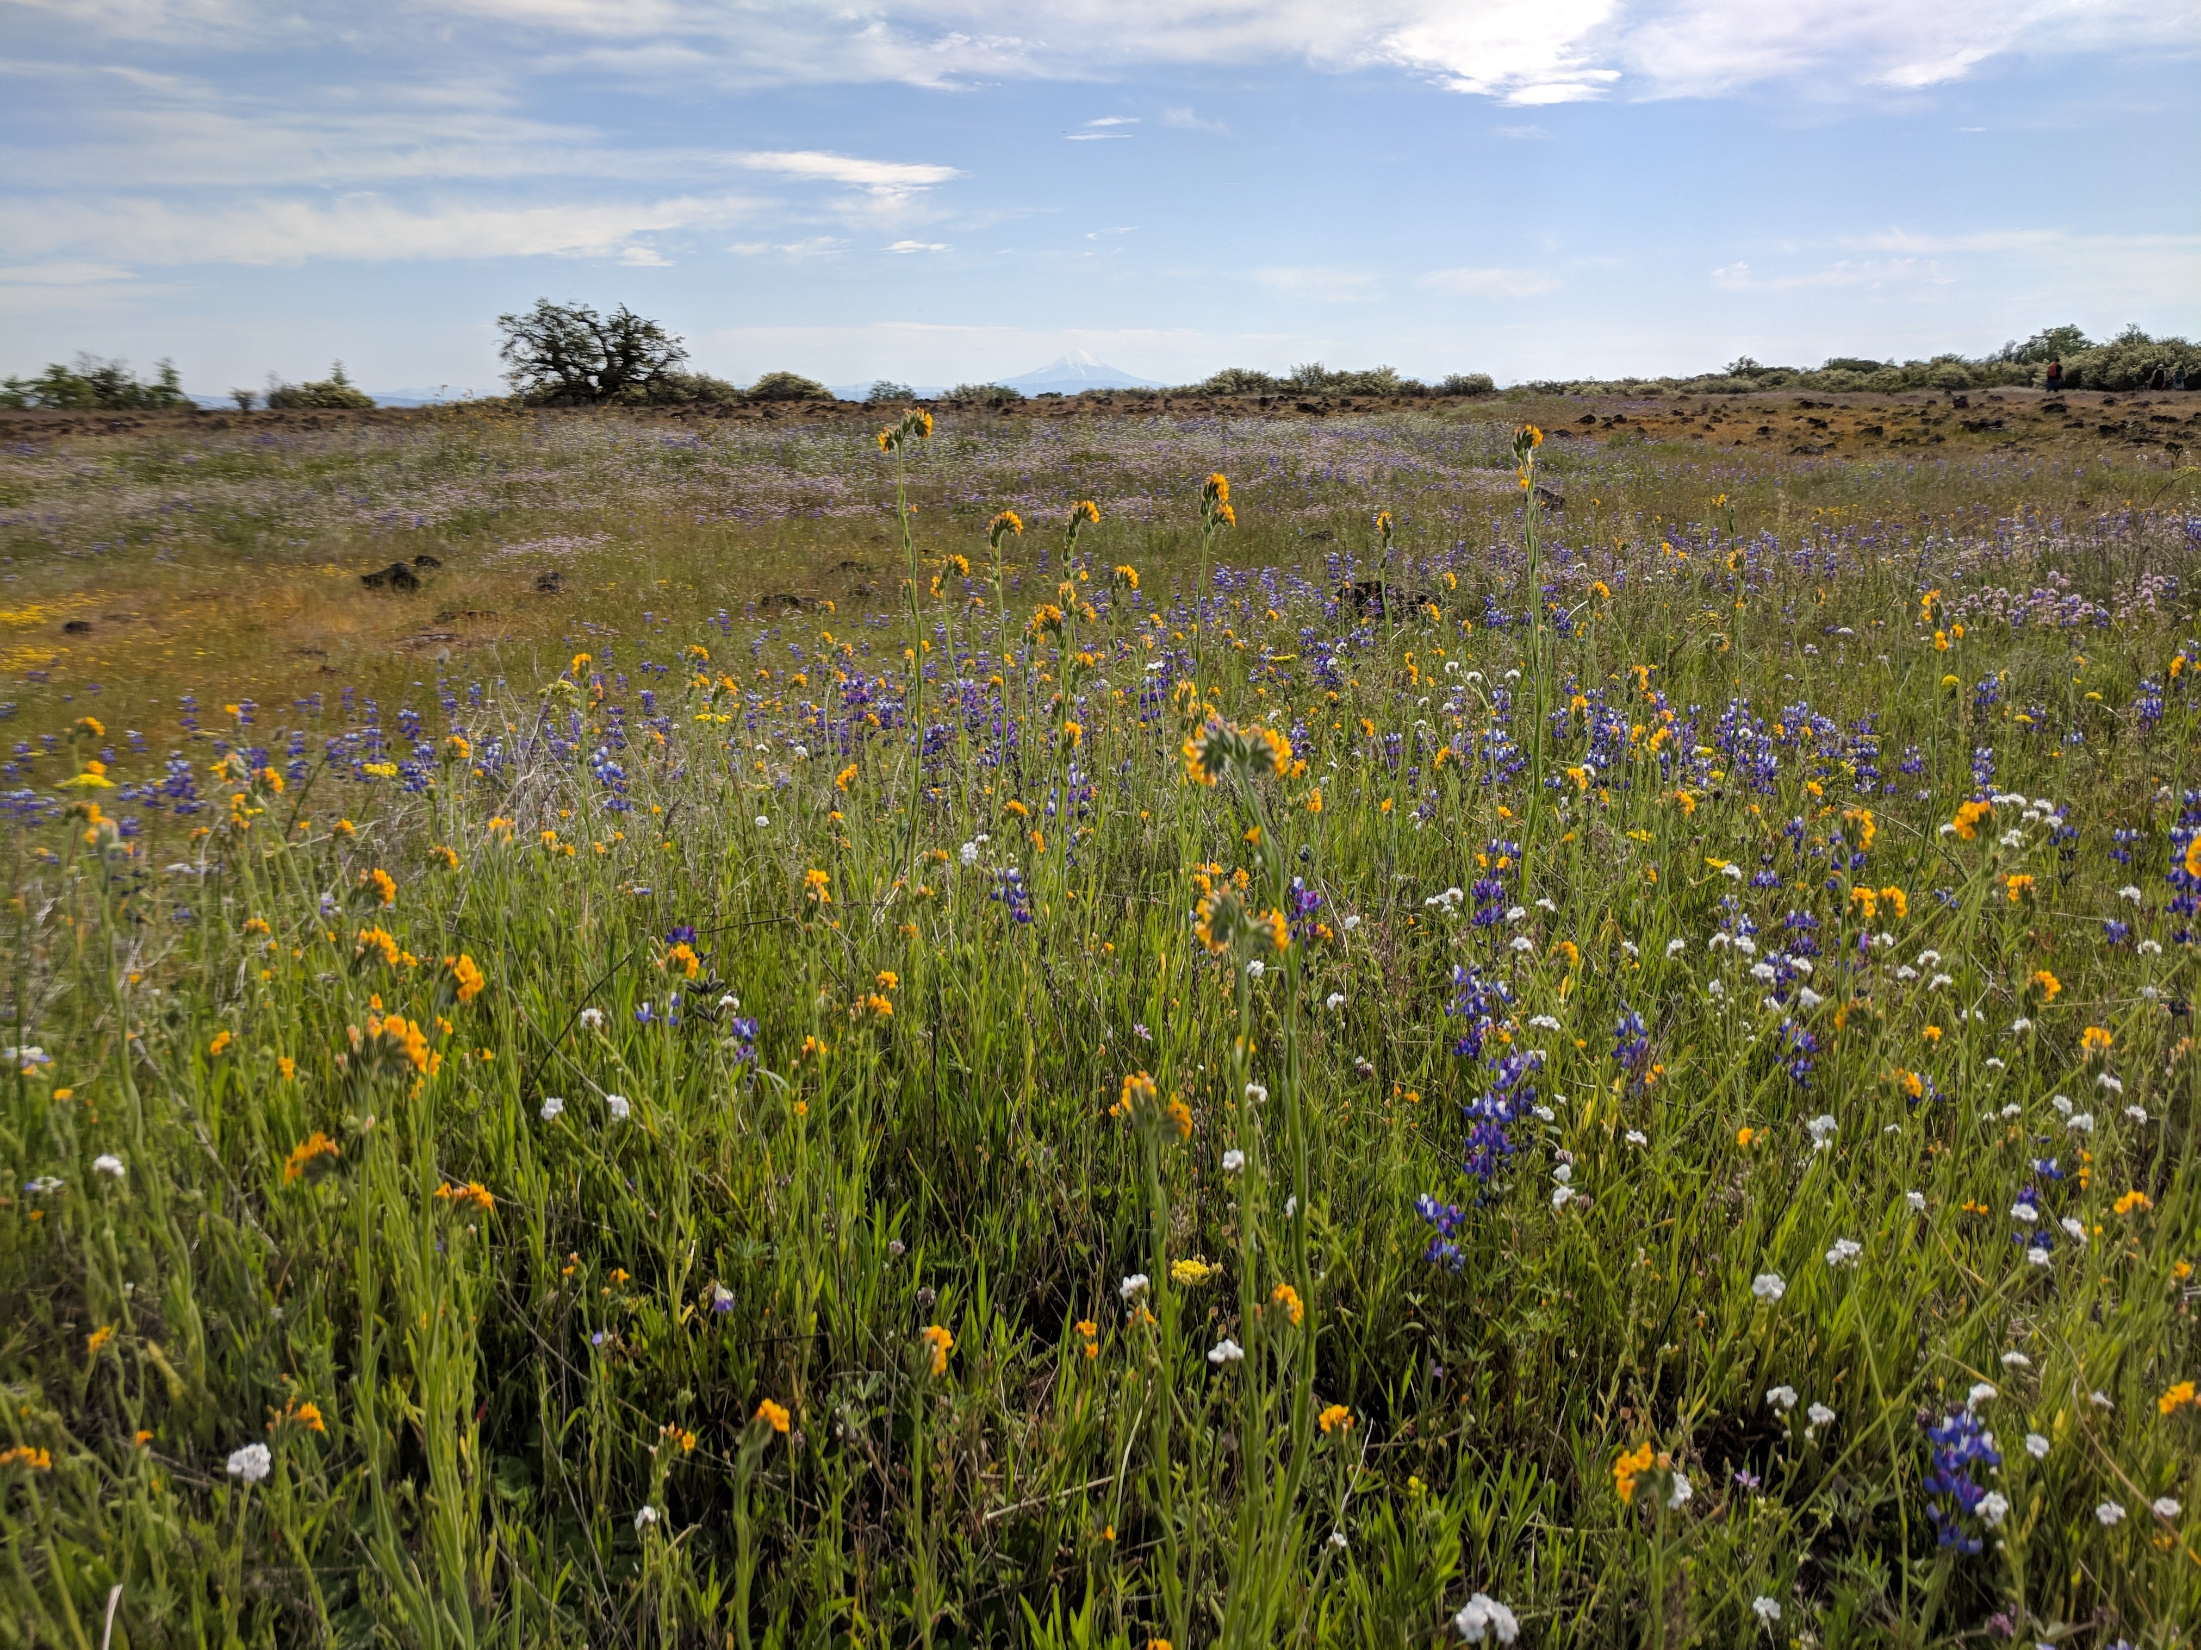
Notes:
An age old question in ecology is whether communities such as this are the sum of their parts—Does something new emerge when we put two, three, ten or twenty species together that isn’t there when the species are grown on their own.
On one hand we might hypothesize that if we only understand how each and every pair of species interacted in the community that would be enough for us to understand and predict the behavior of the entire multispecies community.
One the other hand, we might be skeptical of this reductionism: does understanding how each pair of species interact, leave something out when we put them together into a multi-species community?

Slide 3
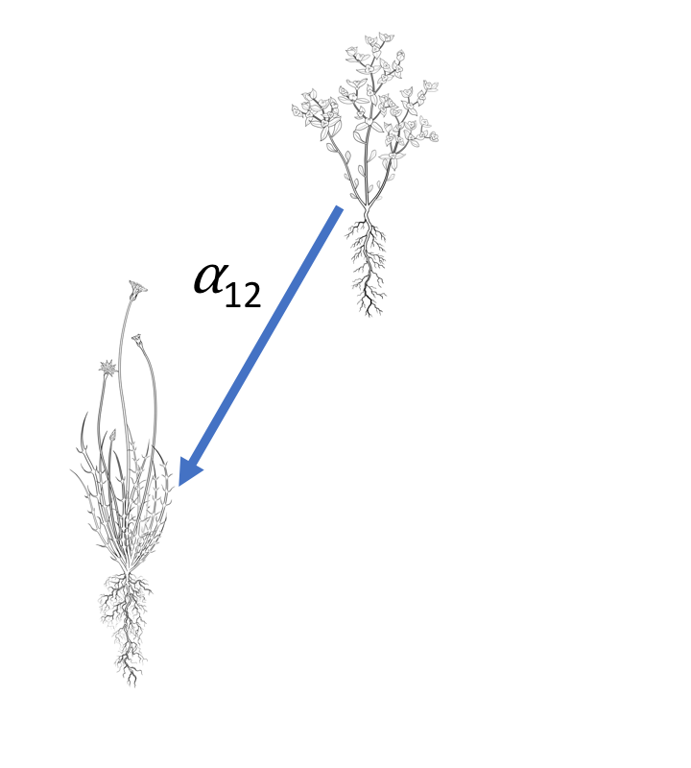
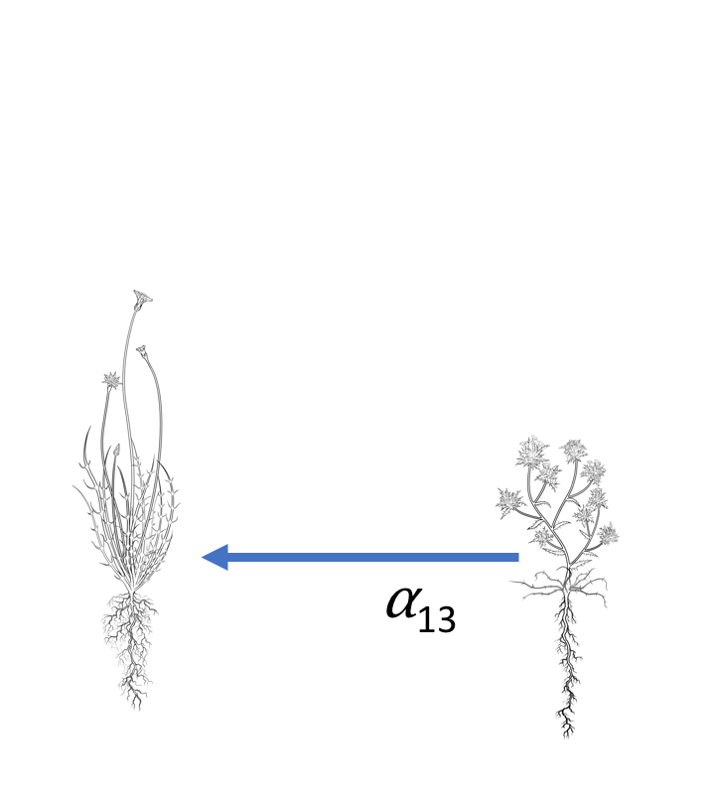
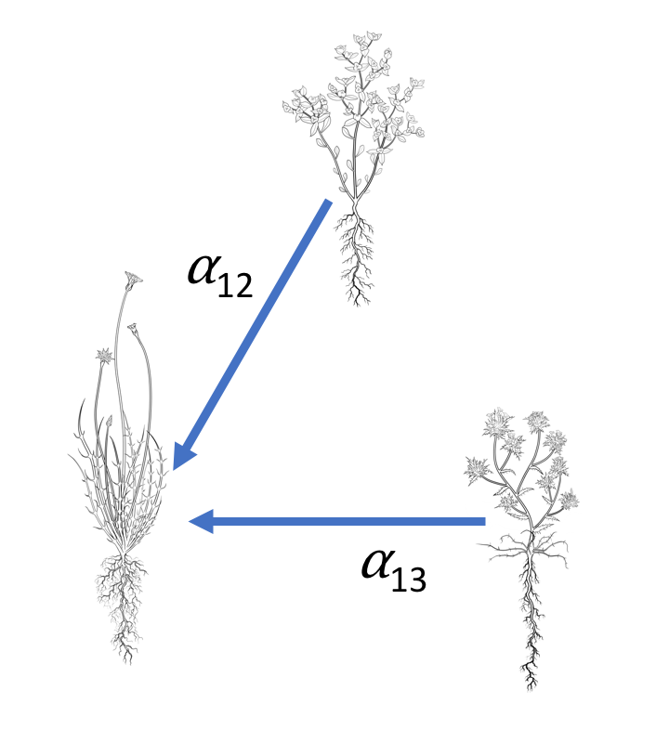
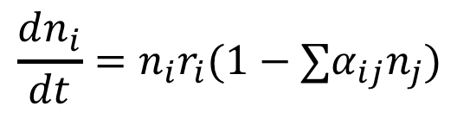
Competition models
Pairwise
Additive
$$\frac{dn_{i}}{dt}=n_{i}r_{i}(1−∑α_{ij}n_{j})$$
2
+
1
1
3
Illustrations, Joanna Shih
Notes:
We can get a more specific idea of what this question is all about when we consider a classical competition model such as the lotka-Volterra model.
Most competition models assume that competition is pairwise and additive. We parameterize models like this by observing how each species responds to density gradients of each other species growing. In the diagram we fit separate competition coefficients to describe the effect of species two on species one or the effect of species three on one.
If competition is truly pairwise and additive, we can predict from these separate situations how species one will respond to facing both species one and two together at once, we can simply add up the effects of two and three.

Slide 4
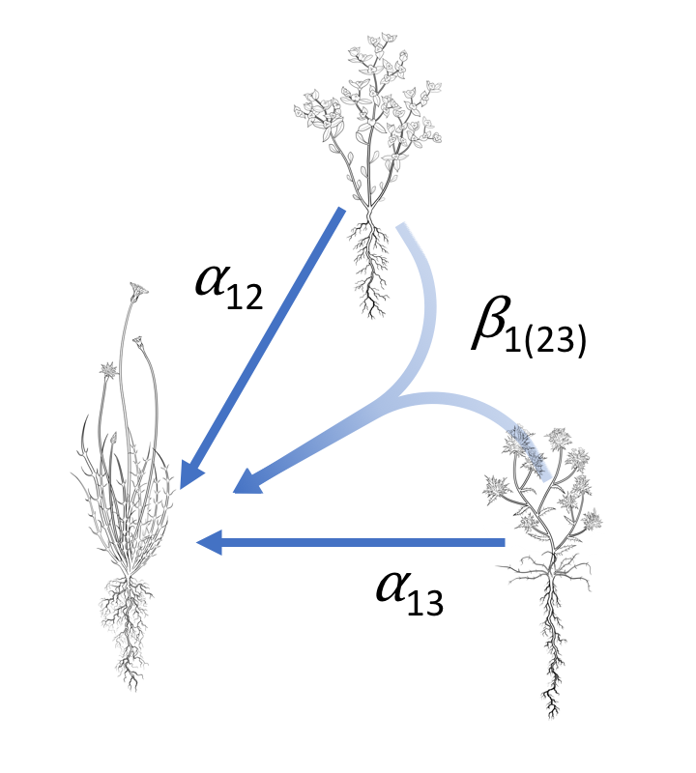
Higher order interactions
2
Non-Additive
HOI
1
3
Notes:
However, if interactions are non-additive, then we cannot predict the response of species one to species two and three together by simply adding up their separate effects.
If competition is non additive then there must be higher order interactions in the system non-additivity is to hypothesize that there are higher order interactions in the system.
That is the presence of two and three together somehow changes the dynamics of the system.
If higher order interactions are common in nature this presents a serious problem both practically and theoretically for community ecology. Practically it means that we cannot hope to understand multispecies communities with only pairwise interactions.
We need to run many, many more experiments in order to understand dynamical models that include higher order interactions.
Philosophically, it means that communities have emergent properties that cannot be easily reduced to pairwise interactions. And it argues for new theories of community ecology.

Slide 5
Questions
How can we detect higher order interactions?
What causes higher order interactions emerge?*
*especially for plants
Notes:
The two main questions I’m going to address today, are first how can we detect higher order interactions?
And second, what sorts of mechanisms could produce higher order interactions among competing species?
This second question is focused mostly at competing plants. Among animals we know that higher order interactions can emerge due to changes in behavior of animals in multispecies communities. However, ecologists haven’t developed similar explanations for plants, and there is very little empirical evidence for or against higher order interactions among competing plants.

Slide 6
Outline:
Simulate resource competition
Fit pairwise model to two species communities
Predict dynamics in three species communities
Evaluate higher order interactions
Notes:
Since, there is are so few empirical data to work with, our approach here was to first
Simulate some artificial plant communities using a mechanistic but very simplified model of species competition, that assumes nothing about higher order interactions.
Fit additive competition models to all the simulations involving pairwise competition.
Using the fitted additive competition models, we will then predict the effects of multispecies competition.
Finally we can evaluate the presence of higher order interactions by comparing the response to competition predicted by the additive models to the response “observed” in the simulation

Slide 7
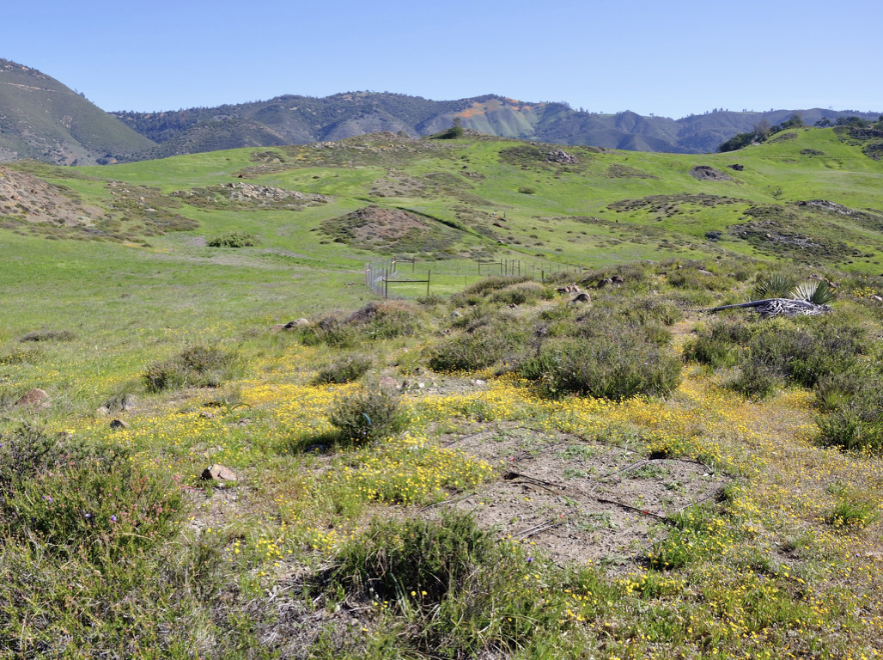
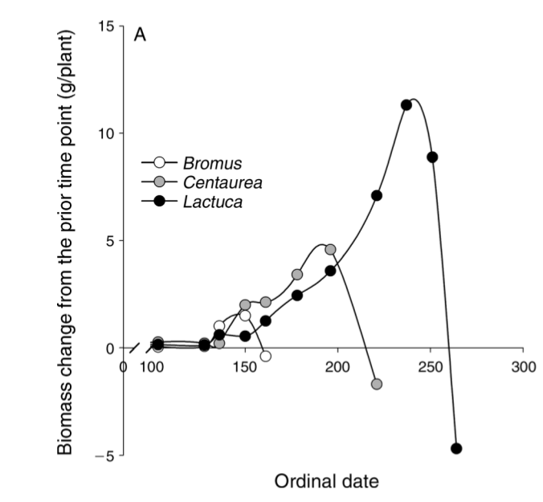
California annual plants
Godoy and Levine (2014)
Notes:
The simulation model we developed is inspired by the life history of California annual plants.
In California the rainfall is restricted to the winter and early spring.
This means annual plants have a very limited window of time when soil resources are sufficient for growth, basically from late winter into spring, and then in the summer things get too dry and all the plants flower and senesce.
This figure from work by Oscar Gody and Jonathan Levine shows the typical growth trajectory of three annual plant species over the course of a growing season.
You can see that these species each reach a point during the year where the stop growing, and this is a species specific traits.
The species shown in white grows early and then stops growing at about day 150.
While the species shown in black is a late season species that grows late into the summer and stops growing at day 250.

Slide 8
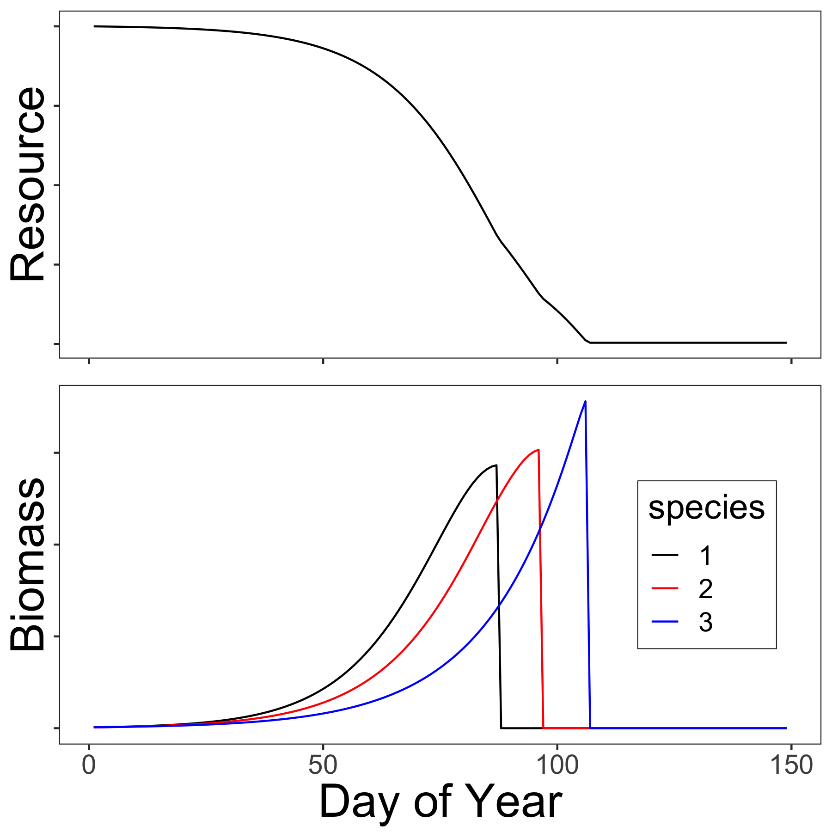
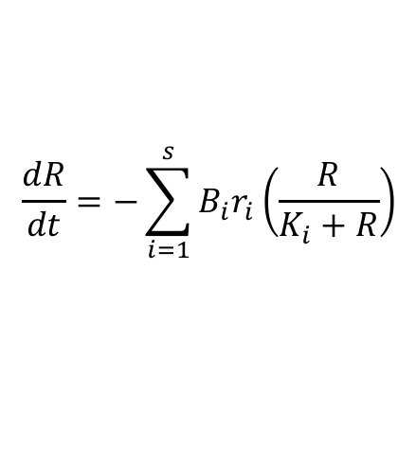

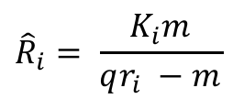
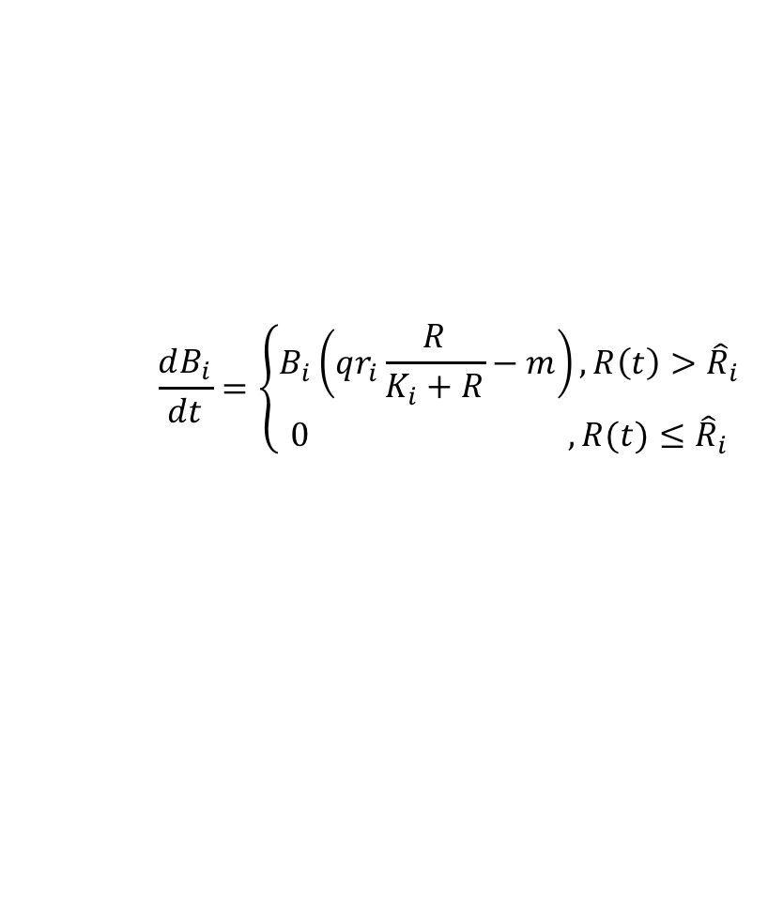
Simulation model
$$\frac{dR}{dt}=−\sum_{i=1}^{s}{B_{i}r_{i}\left(\frac{R}{K_{i}+R}\right)}$$
$$\frac{dB_{i}}{dt}=\left\{\begin{aligned}B_{i}\left(qr_{i}\frac{R}{K_{i}+R}−m\right), R\left(t\right)>{\hat{R}}_{i} \\ 0 ,R(t)≤{\hat{R}}_{i}\end{aligned} \right.$$
$${\hat{R}}_{i}= \frac{K_{i}m}{qr_{i} −m}$$
$n_{i }=h(B_{iF})/μ$ Biomass to seed conversion
Notes:
So created a simulation model that captures some of these dynamics.
It explicitly tracks a single resource, which you could imagine is soil moisture. In this figure on the right you can see the resource is continually declining throughout the year.
Plants draw that resource down over time and it is never replenished--reflecting the lack of spring and summer rain in this system.
Plant growth, is shown in this lower figure on the right. You can see the growth trajectories of three different species shown in different colors. Species one is the earliest species shown in black, species two shown in red grows a little later into the season, and species three is the latest growing species shown in blue.
The differences in phenology and growth shown by these species are entirely due to just two parameters in the model, they have different maximum growth rates, r and different resource have saturation constants K.
Growth is given by this piecewise function shown here, where resource concentrations are great enough to ensure positive growth for that species the species grows, but when resource concentrations get below a certain level, then the growth can no longer be positive and I set growth to zero.
This determines the end point of each species growing season, at this point each species will reach it’s maximum biomass, and I make the assumption that this biomass is converted by some conversion function to seeds for the next year.

Slide 9
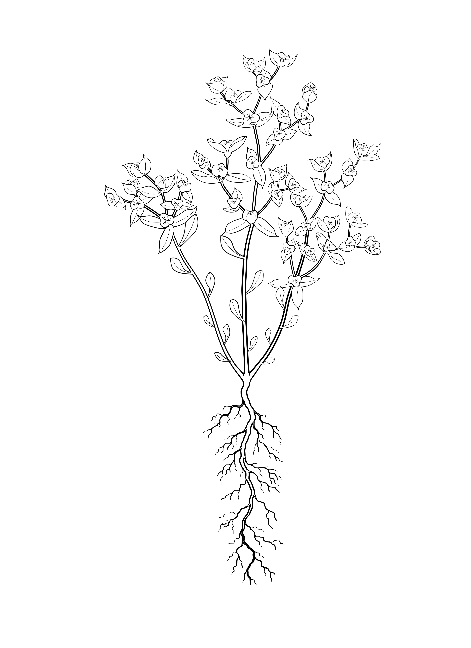
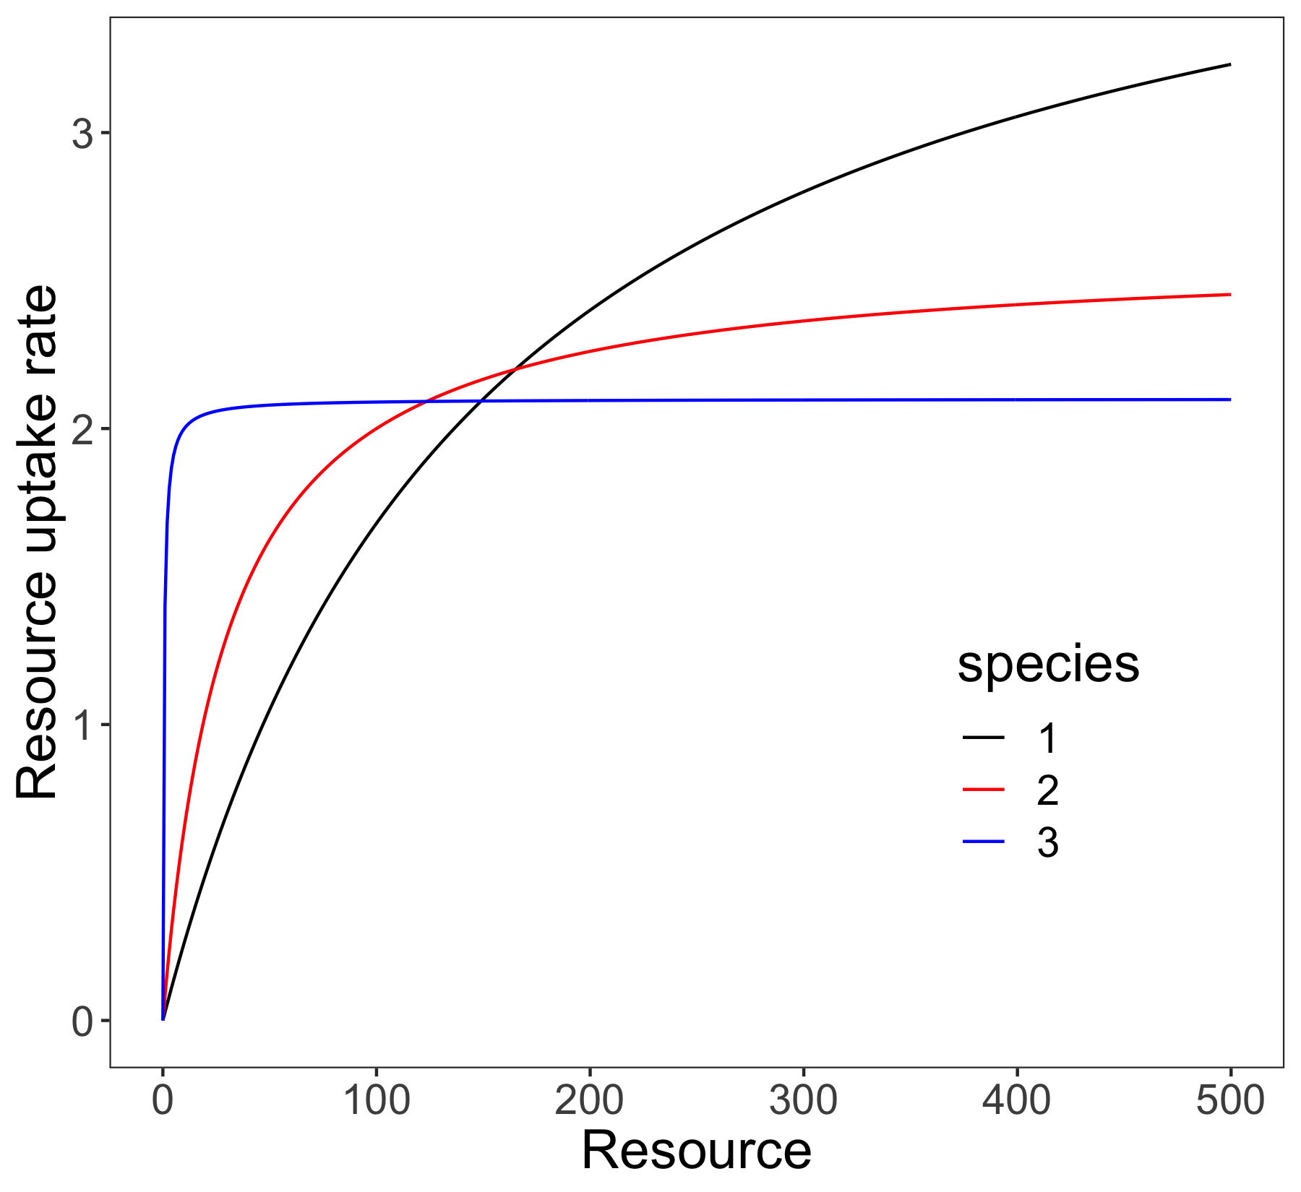
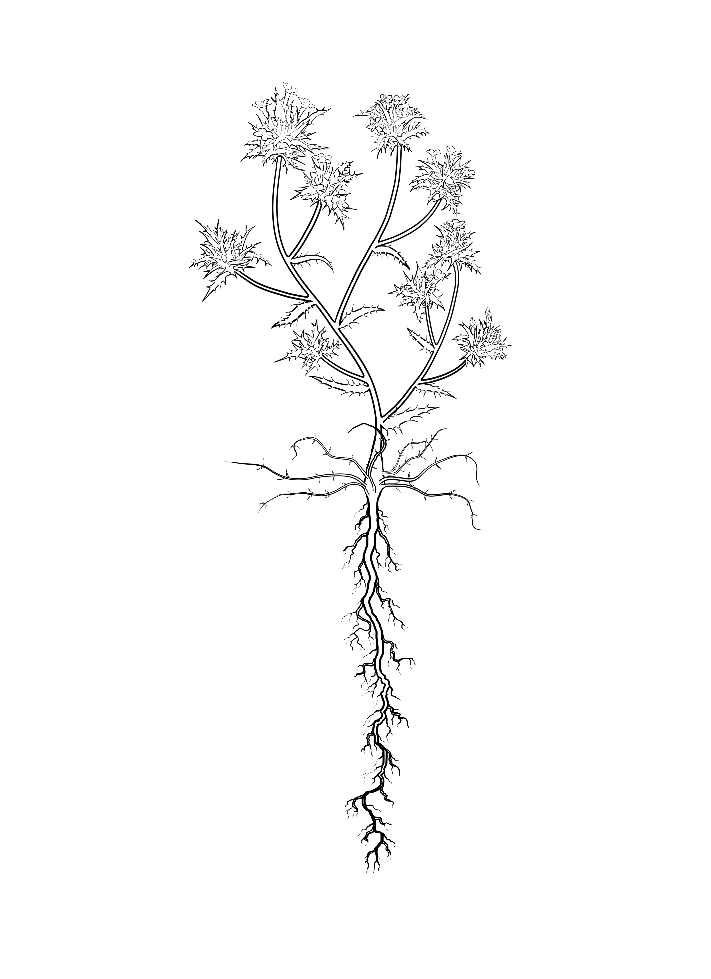
Species differences
early
middle
late
Notes:
Just to get a better idea of how these species differences come about, you can see that species one, the black curve has the fastest maximum growth rate but it’s growth rate declines most rapidly as the resource level is reduced.
Species three on the other hand, shown in blue, is like a very late season species, it has the slowest maximum growth rate but it is able to keep growing at very low resource levels.
Species two is somewhere between the two.

Slide 10
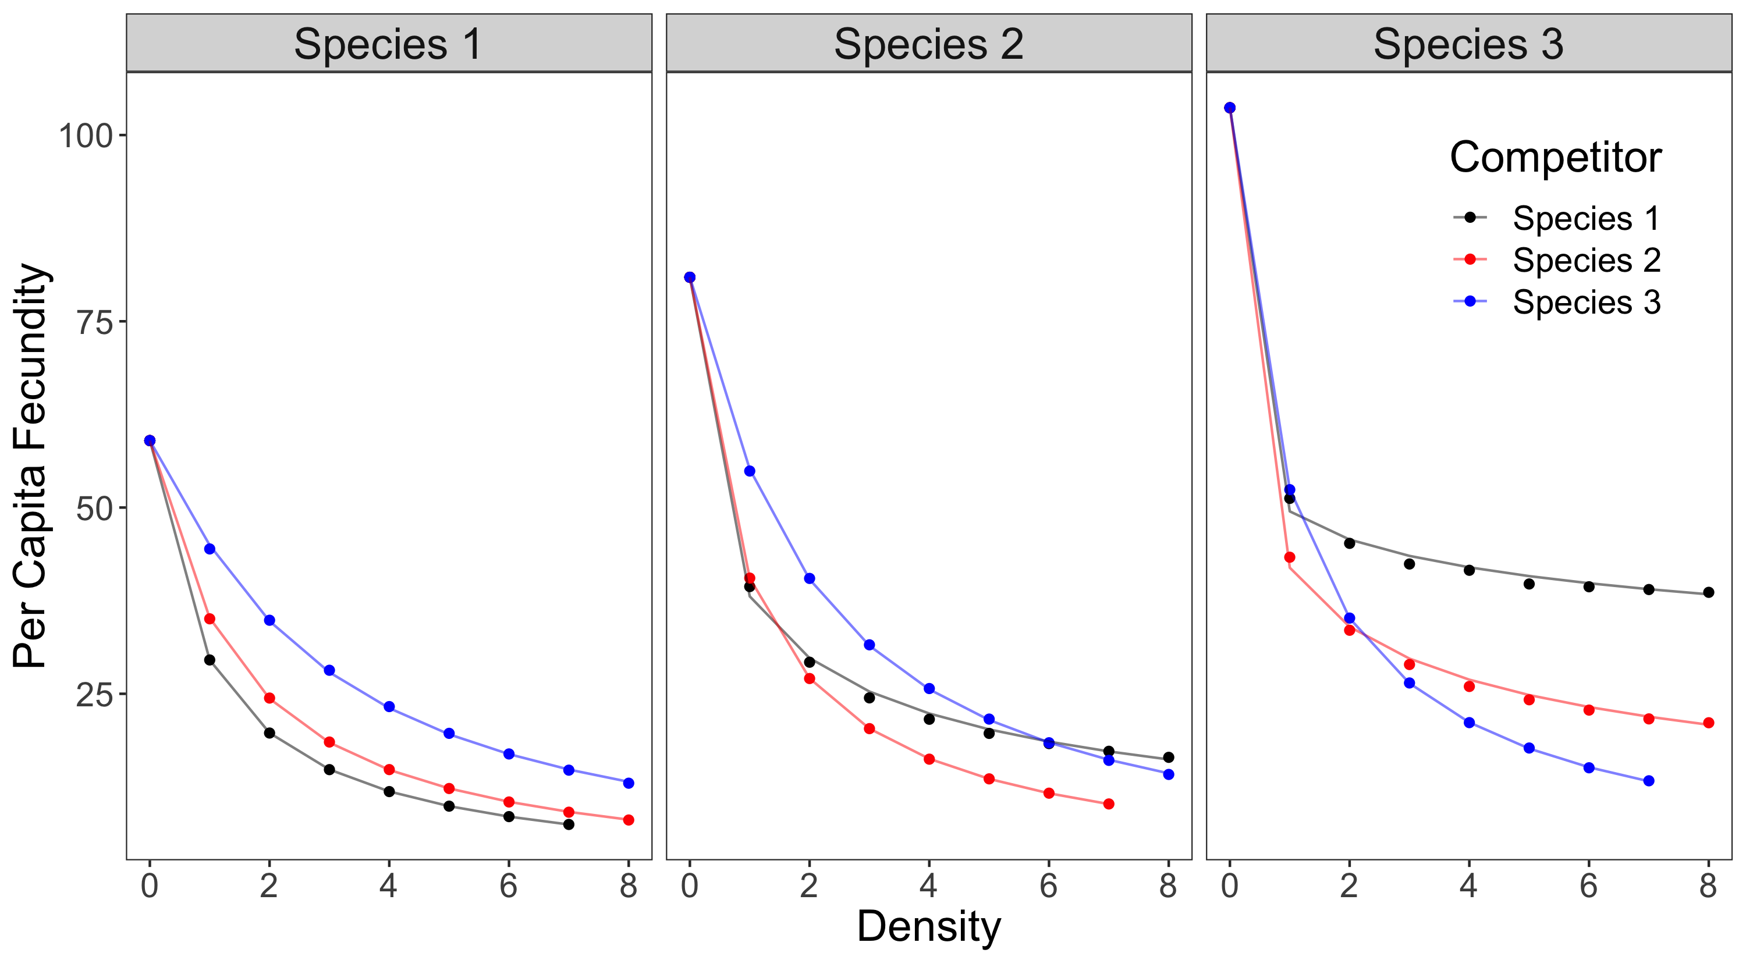
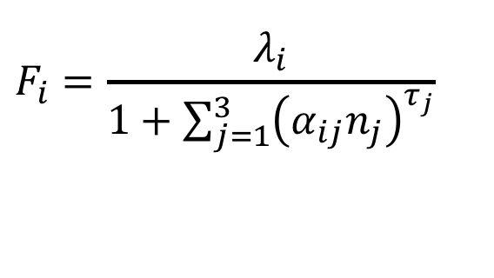
Competition
$$F_{i}=\frac{λ_{i}}{1+\sum_{j=1}^{3}{{\left(α_{ij}n_{j}\right)}^{τ_{j}}}}$$
Notes:
Ok so what do the competitive effects look like in this system.
On the x-axis of each figure is the starting density of a competing species, either one, two or three. These numbers represent the number of seeds, or the number of individuals of the each competitor species in the system. On the y-axis is the per-capita fecundity of species one, two and and three. Figure one is shown on the left, two in the middle and three on the right.
Now I want to make this part really clear, the dots are showing the simulated per capita fecundity from the mechanistic model I just described.
Here on the left you see the response of species one two the density of species three (shown in blue), species two, shown in red, species one shown in black in so on.
The lines are the fitted response produced by an pairwise competition model of this form shown up here. This is a modified Beverton holt model similar to the annual plant model that is commonly used in Peter Chesson and Jonathan Levine’s work.
The take home here is that this pairwise model, the lines, fits the points, the simulations, really well. The pairwise model, accurately captures the effects of competition in this system.
So the big question here is how will this pairwise model hold up when we move to a multispecies situation? That is for example, if simulate a case where species one is facing competition from species two and species three together, can we assume that these pairwise effects are additive? Or are their higher order interactions between two and three that make make multi-species competition non-additive?

Slide 11
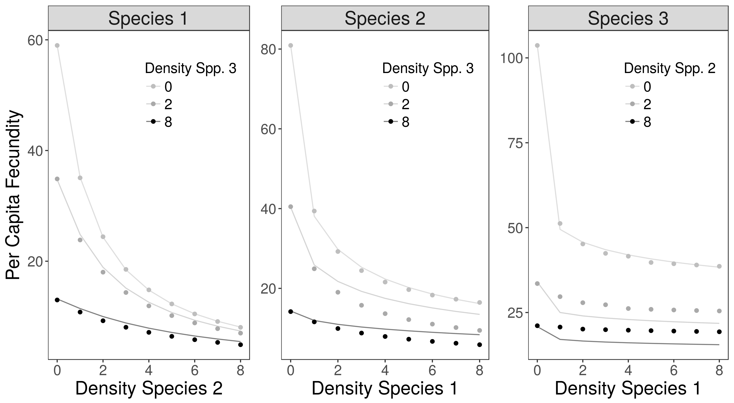
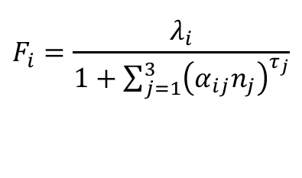
Multispecies competition
$$F_{i}=\frac{λ_{i}}{1+\sum_{j=1}^{3}{{\left(α_{ij}n_{j}\right)}^{τ_{j}}}}$$
Notes:
So here we are testing that assumption of additivity.
This figure shows the per capita fecundity of species one, on the y-axis, with the density of species two as a competitor on the x-axis. The three different lines going from light gray to black show three different densities of species three. So if we consider these point here on the bottom right, these are multi-species communities, where one is facing competition from both species two and three together.
The lines are showing the predicted response given by the additive model fit to the pairwise competition.
You can see that here for species one, the assumption of additive competition holds up well. There is some discrepancy between the predicted and observed response but it’s not very great.
So let’s examine the same plots for species two and three….

Slide 12
Multispecies competition
$$F_{i}=\frac{λ_{i}}{1+\sum_{j=1}^{3}{{\left(α_{ij}n_{j}\right)}^{τ_{j}}}}$$
Notes:
So here in the middle panel is the response of species two. You can see that the additive model is predicting greater per capita seed production in the multispecies community than observed—that is these lines are above the simulated response shown by the points.
On the other hand for species three on the right, the additive model is under-predicting the per capita seed production of species three. That is the lines are below the simulated response.
What does this mean?

Slide 13
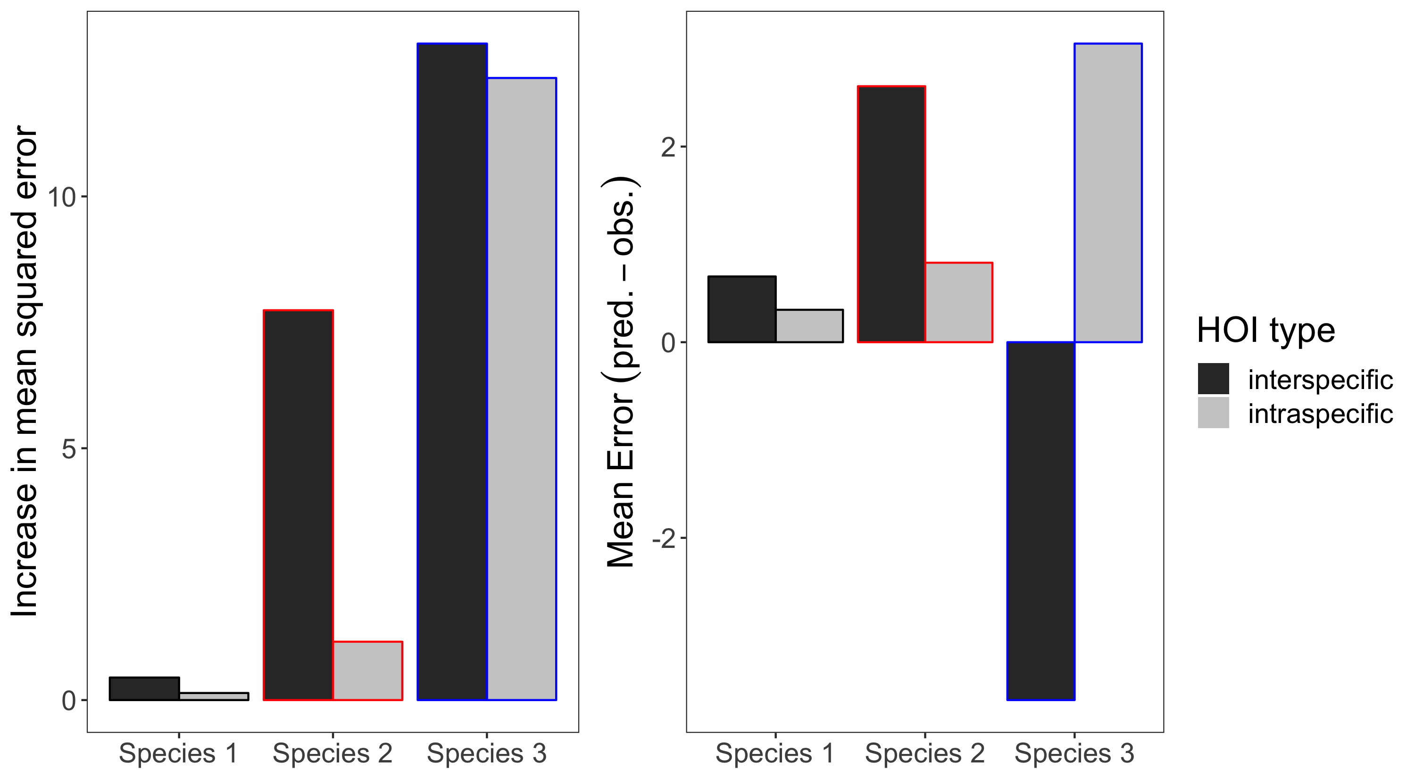
Strength of HOIs
Notes:
Another way to look at this is to plot the mean squared error of the additive model for each species when applied to multispecies settings.
So the figure on the left is showing the mean squared error of the additive model when applied to the multispecies simulations.
And you can see that the error for species one is really low and the error for species two and three is really large.
I take this as evidence that higher order interactions are more important for species two and three than for species one.
You can also see on the figure on the right the direction of the errors. For species one and two, the additive model predicts per capita fecundity that is greater than observed. Meaning that multispecies competition is stronger than additive competition.
For species three the direction of the error depends on whether intraspecific competition is involved: when the multispecies community is made up of interspecific competitors then the additive model predicts per capita fecundity that is lower than observed, so that the effects of multispecies competition is weaker than expected by the additive model.
This discrepancy between the additive model predictions and the multispecies simulations, can be seen here as evidence that competition is non-additive in this system, and so therefore there must be higher order interactions.

Slide 14
Questions
How can we detect higher order interactions?
What causes higher order interactions emerge?*
*especially for plants
Notes:
Going back to the questions I posed at the beginning, we’ve just seen how we can use additive models fit to single species competition, to detect higher order interactions in multispecies communities. In short, if our assumption of additive competition fails then there must be some higher order interactions at work.
The next question, the one you’re probably asking right now which is why do these higher order interactions emerge in the simulations?

Slide 15
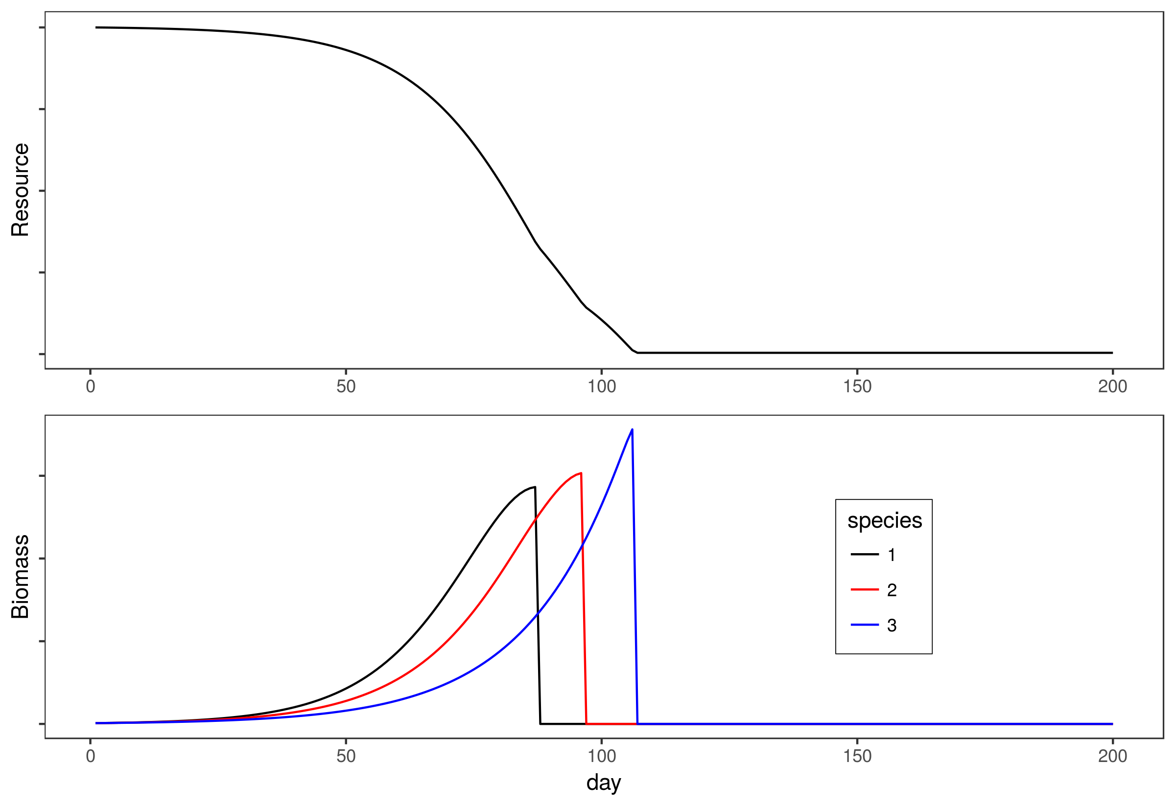
What causes higher order interactions?
Differences in timing of growth and resource use
Notes:
I think the key to understanding this is that each species in this system has different timing of growth and resource use. Each species grows most rapidly at a different time, and earlier species, stop growing and competing once they flower.
You can break the growing season up into sections,
In phase one, all the species are actively growing and competing,
In phase two its just two and three,
and then in phase three it’s just species three alone.

Slide 16
What causes higher order interactions?
Higher order interactions on species 3
2
1
3
Notes:
To see how this might lead to higher order interactions, consider here how competition affects species three throughout the course of the growing season.
You start out with all three species active

Slide 17
What causes higher order interactions?
Higher order interactions on species 3
2
1
3
Notes:
Species one grows fastest early and it has a stronger effect on species two (shown by the thick arrow) and a weaker effect on species three (the thinner arrow).

Slide 18
What causes higher order interactions?
Higher order interactions on species 3
2
1
3
Notes:
Species one stops growing early in the season—I’m showing that here with the empty circle. At this point species two is having a strong effect on species three.

Slide 19
What causes higher order interactions?
Higher order interactions on species 3
2
1
3
Notes:
Then species two stops growing next, and it stops influencing the growth of species three and species three takes off.
By considering this chain of events you can imagine that the presence of species one can modify the effect of species two on species three, and vice versa. Specifically species one weakens the effect of two on three by reducing the growth of two more than three early in the growing season.

Slide 20
What causes higher order interactions?
Higher order interactions on species 3
2
1
3
2
-
HOI
+
3
1
-
Notes:
An additive competition model for species three, including only arrow, here and here, cannot capture the interaction between one and two.
Thus when we attempt to describe the joint effect of one and two together on three we have to include some sort of higher order interaction. In this case the effect of the multispecies community is less than predicted by the additive model.

Slide 21
Conclusions
Detecting higher order interactions requires good pairwise models
Differences in timing of growth may lead to HOIs in discrete time models
Notes:
Ok so hopefully that wasn’t too confusing. But it’s hard to explain these things.
Some take home messages for this session:
First we can detect higher order interactions only if we have models that accurately predict pairwise dynamics.
Second, our very simple single resource simulations suggest that higher order interactions can emerge in discrete time models when we are dealing with plants that differ in their timing of growth and competition. I think this scenario is probably really common in nature and so I would not be surprised if some higher order interactions are common in plant communities

Slide 22
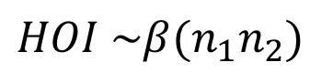
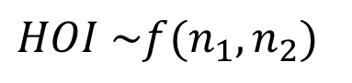
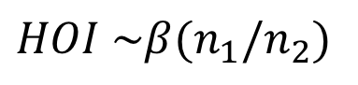
Conclusions
Detecting higher order interactions requires good pairwise models
Differences in timing of growth may lead to HOIs in discrete time models
Modeling the functional form of higher order interactions remains a problem
$$HOI \sim β(n_{1}n_{2})$$
?
$$HOI \sim β(n_{1}/n_{2})$$
?
$$HOI \sim f(n_{1},n_{2})$$
?
Notes:
Finally I showed you something of how we might find evidence of higher order interactions but I didn’t really figure out the functional form of those higher order interactions-–are the simply proportional to the product of the competitor’s densities? Does the ratio of competitor densities change the strength of higher order interaction?

Slide 23

Acknowledgements
Kraft Lab:
Mary Van Dyke
Suzanne Ou
Guarav Kandlikar
Ian McFadden
Notes:
I’d like to thank the kraft lab and funding from NSF and UCLA for this research.

